Slide 1
XANES Analysis of Lithium Transitional Metal Oxides with Neural Networks
Mindren Lu
01/07/2019 – 02/01/2019

Slide 2
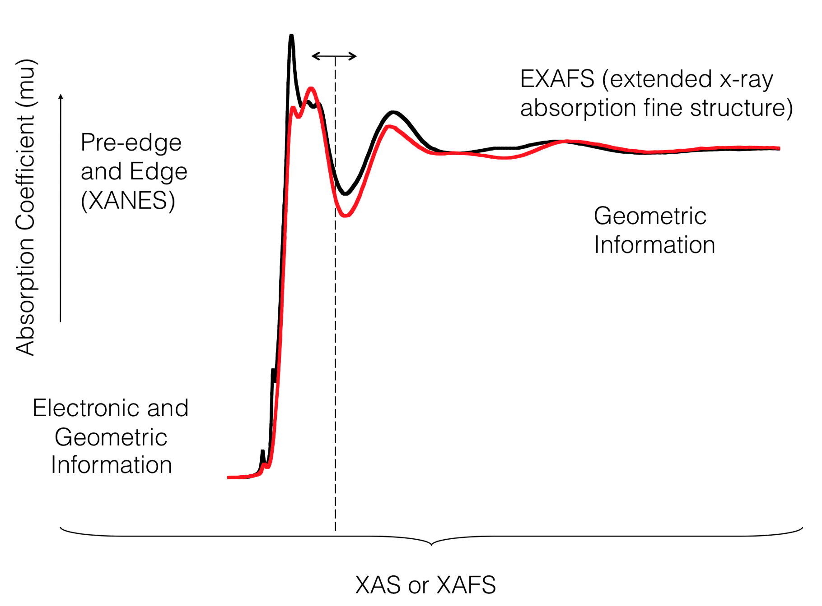
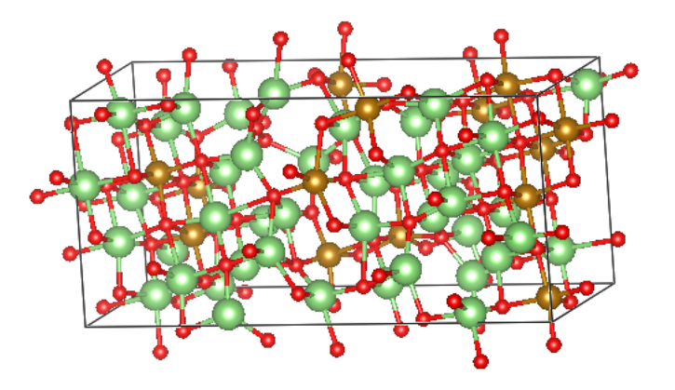
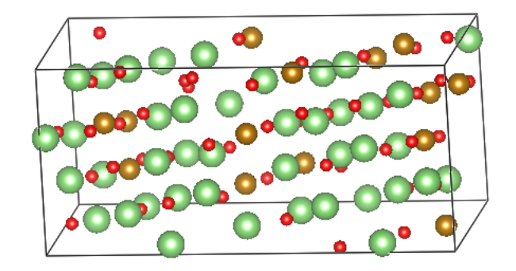
Background
Studying Li3FeO3.5 structures and their potential for battery storage
Fe coordination number of oxygens
Charge on oxygen atoms
Using x-ray absorption near edge structure (XANES) from spectroscopy at the Argonne Advanced Photon Source as inputs to a neural network; used to predict these two values
(R. Sarangi)

Slide 3
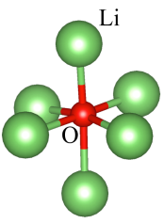

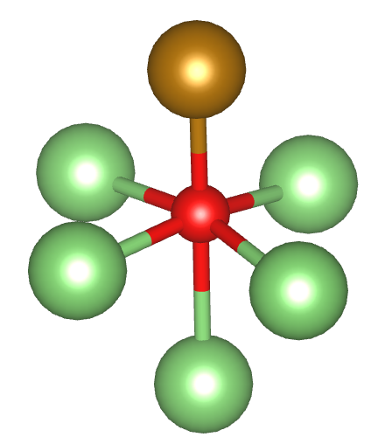
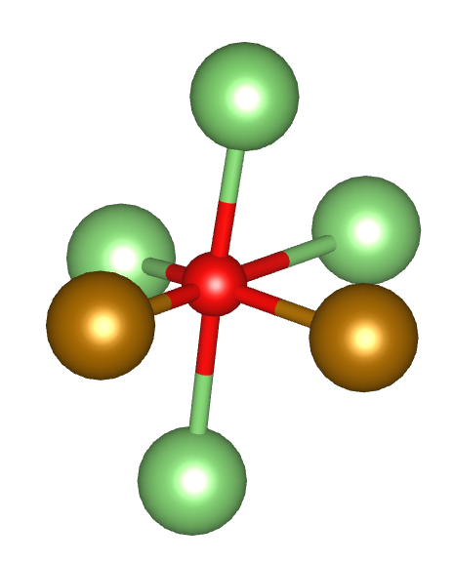
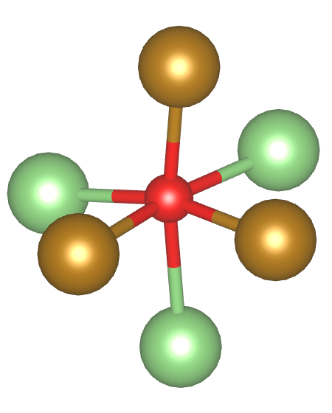
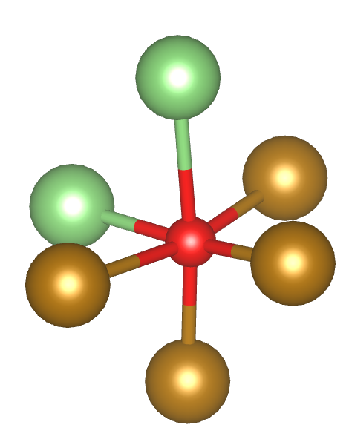
Single Spectrum Analysis
cutoff radius
2.6 Å
Li
O
Fe
Objective: given a XANES spectrum for a single oxygen atom, predict its Fe coordination number
Multi-class classification: coordination number is 0, 1, 2, 3, or 4
18 Li3FeO3.5 structures used, 49 spectra per POSCAR/CONTCAR file
882 examples: 64% train set, 16% cross-validation set, 20% test set
Neural network: written in Python and Tensorflow, 2 hidden layers
Goals: use tools and hyperparameters to speed up learning, and reduce overfitting
Overfitting: when the model fits too closely to the training data and fails to generalize to the test data
(Liang Li)

Slide 4
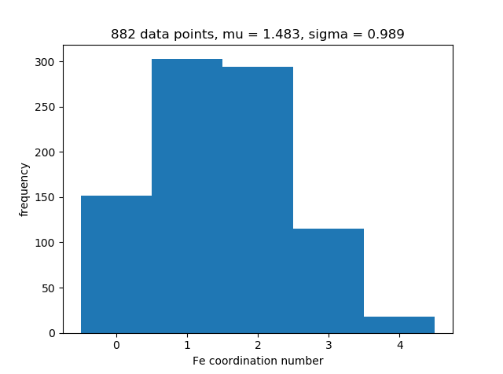
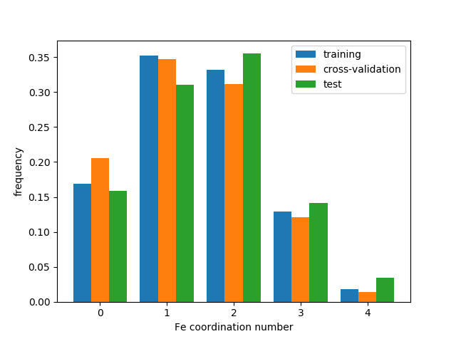
Data Distribution
(normalized)

Slide 5
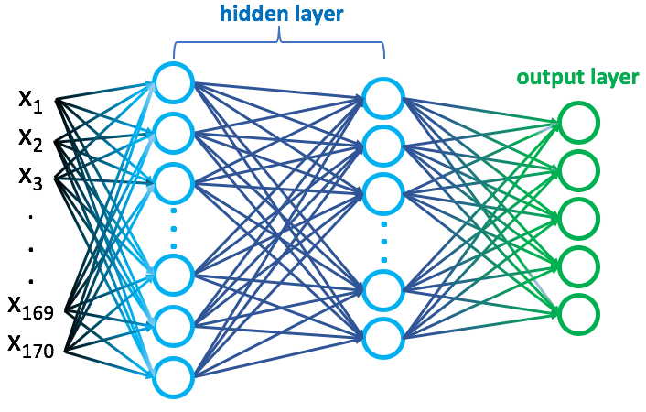
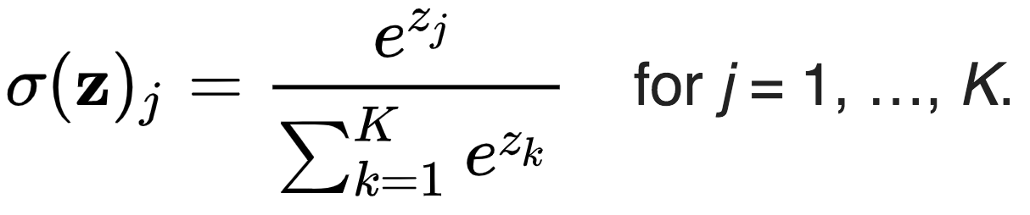
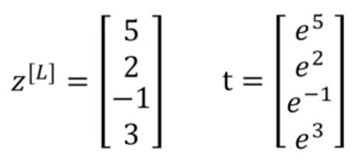
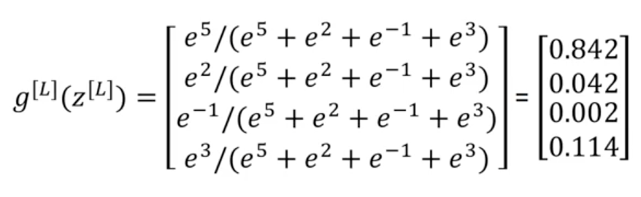
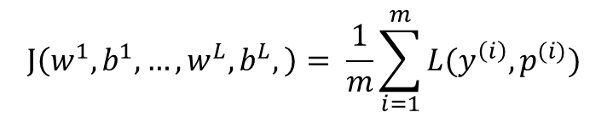
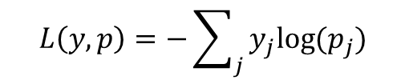
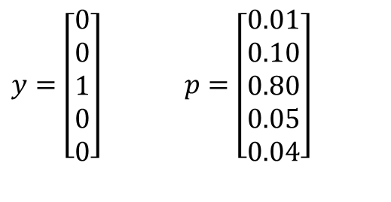
Machine Learning Overview
(5 x 147)
(170 x 882)
$y=\left[\begin{aligned}0 \\ 0 \\ 1 \\ 0 \\ 0\end{aligned}\right]$ $p=\left[\begin{aligned}0.01 \\ 0.10 \\ 0.80 \\ 0.05 \\ 0.04\end{aligned}\right]$
$$L\left(y,p\right)=−\sum_{j}{y_{j}log⁡(p_{j})}$$
Output Layer: Softmax
$$J\left(w^{1},b^{1},…,w^{L},b^{L},\right)= \frac{1}{m}\sum_{i=1}^{m}{L(y^{\left(i\right)}, p^{(i)})}$$
(Liang Li)

Slide 6
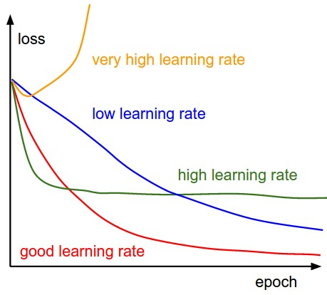
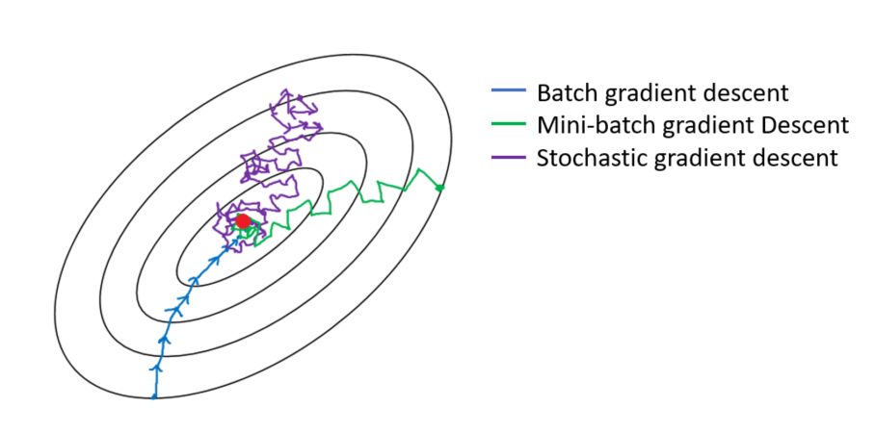
Tools & Hyperparameters to Improve Learning
Learning rate
How large of a gradient step the network takes at each iteration
0.0003 found to train the most accurate models; 0.0001 as well, but slower convergence
Mini batch gradient descent
On each step of gradient descent, rather than processing the entire training set at once, take a gradient step for every small ‘batch’ of the data
Thus, in one epoch, it can take many more gradient steps, accelerating convergence
With mini batch size of 16: cost function converges to minimum quickly, with low noise
Normalization of input data
For each of the 170 energy levels (eV), normalize all data to have a mean of 0 and a variance of 1; facilitates training because all energy levels can be taken into equal consideration, rather than some outweighing others
(Imad Dabbura)

Slide 7
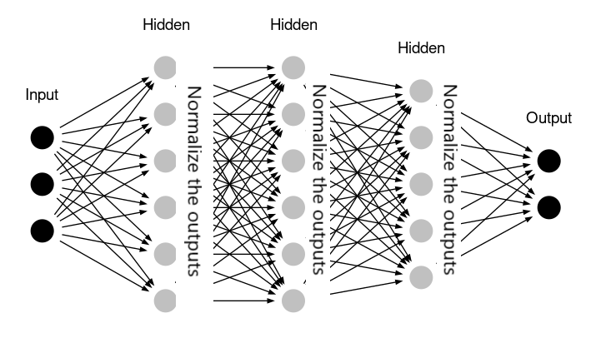
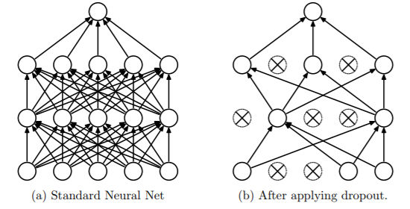
Tools & Hyperparameters, continued
Batch normalization
Like normalization above, but for each mini batch, it’s performed on the outputs of each hidden layer before they are fed into the next layer
Speeds up and improves learning, because the benefits of normalizing the input data are now being found at every layer
Dropout
With a certain probability, some set of nodes in each layer are removed on each training step
Forces the network to take all nodes into account when training, avoids having a lot of weights being set too close to 0
In theory it’s a very effective tool for reducing overfitting, but here it seemed to have little to no effect on the results
There is research suggesting that batch normalization and dropout should not be used at the same time
(Ilango R)
(Srivastava, Hinton, Krizhevsky, Sutskever, Salakhutdinov)

Slide 8
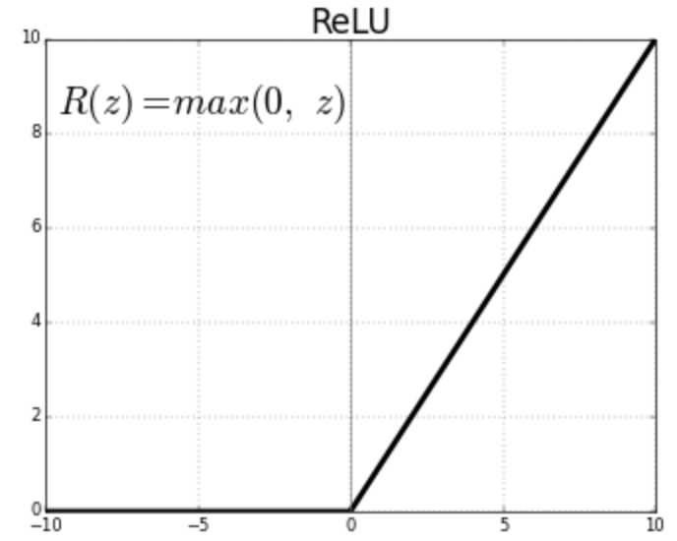
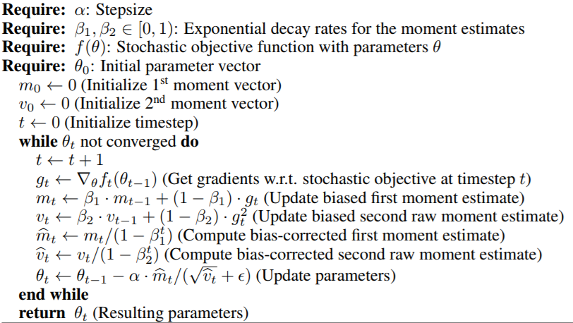
Tools & Hyperparameters, continued
Regularization
A tool to prevent overfitting, penalizes the model from training weights which are too large
Adds the sums of the squares of the weights to the cost function, times a factor
Thus, to minimize the cost function, the weights must be smaller
Hyperparameter to tune: the factor with which to multiply this sum of squares
0.01 found to be effective; 0.03 had similar performance, but was a bit slower to train
Activation functions in hidden layers
Must be included so the model can learn non-linear relations
ReLU (rectified linear unit) in both layers is effective
Optimization algorithm
Adam: most commonly used gradient descent algorithm
(Kingma, Ba)

Slide 9
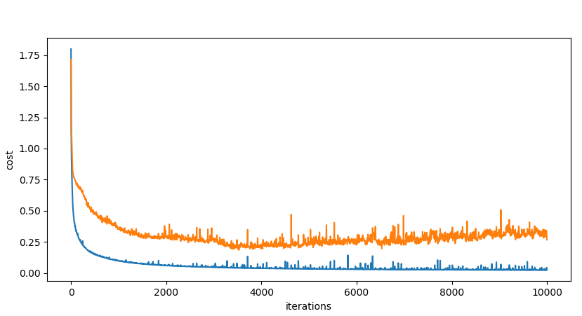
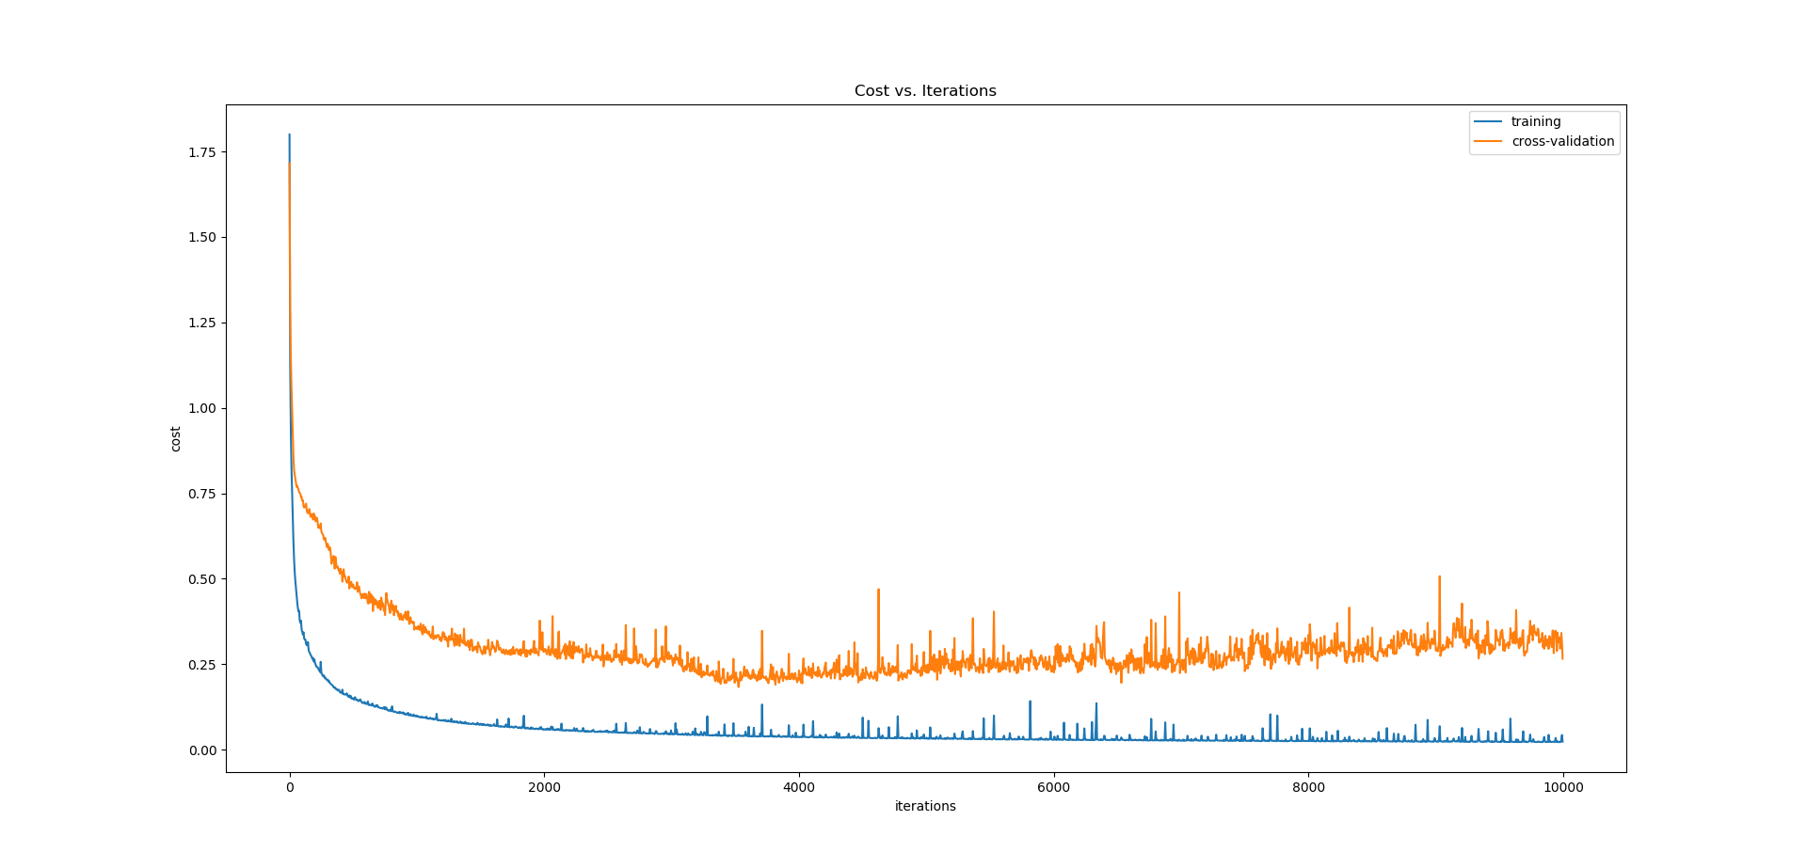
Number of Iterations
Early stopping: stopping training when the cost on the cross-validation set no longer decreases
Used to prevent overfitting – stops training before the network fits too well to the training data and fails to generalize
From the graph, ~4000 iterations is sufficient

Slide 10
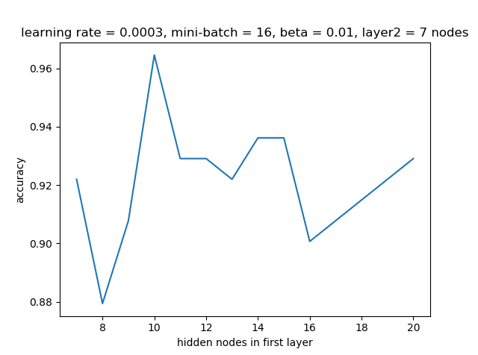
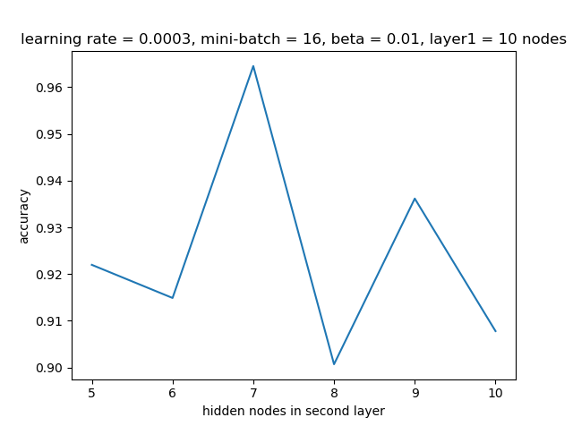
Network Structure vs. Cross-Validation Set Accuracy
set layer 2 to 7 nodes, vary the number of hidden nodes in layer 1
set layer 1 to 10 nodes, vary the number of hidden nodes in layer 2
result: 10 nodes in layer 1, 7 nodes in layer 2 is optimal with the given hyperparameters

Slide 11
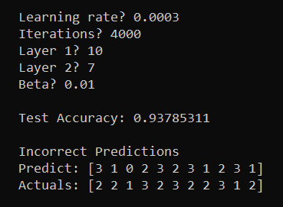
Results
Terminal Output at Test Time
Accuracy of predictions:
Train set: 1.000
Cross-validation set: 0.957
Test set: 0.938
Recall
# of true positives / # of actual positives
No incorrect predictions were made on the labels of 0 and 4, which are the two edge values for the Fe coordination number
Recall is thus 100% for these two labels, suggesting that this is a fairly robust model

Slide 12
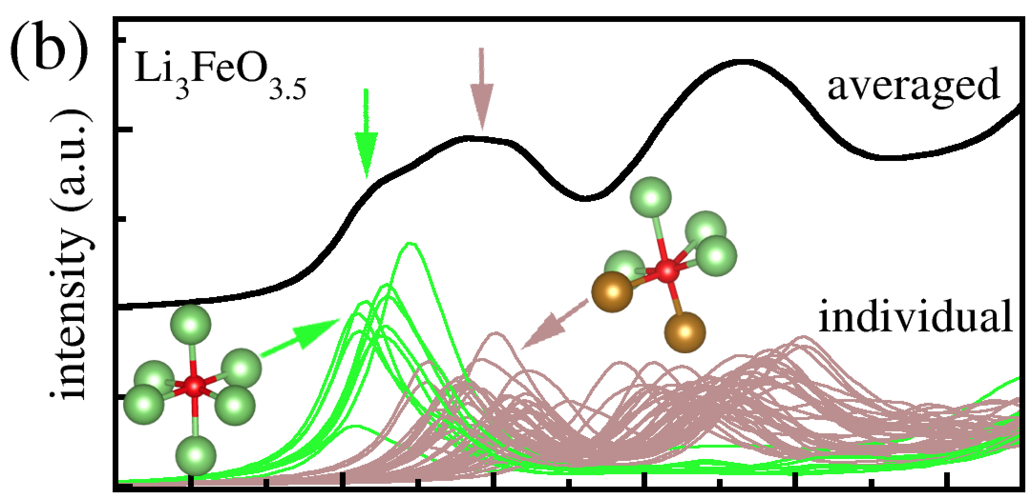
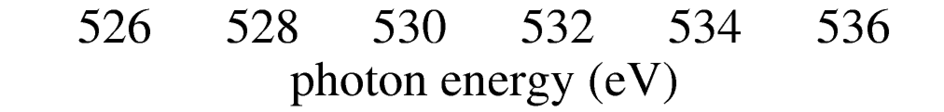
Averaged Spectrum Analysis
Objective: given a spectrum averaged from 49 oxygen atoms, predict the average Fe coordination number among the atoms
18 Li3FeO3.5 structures used, 49 spectra per POSCAR/CONTCAR; 882 total
Data augmentation: randomly combine the 882 spectra, 49 at a time
Any desired number of examples can be generated, up to the upper bound of 882 nCr 49 = 8.99*10^80
10000 used in training this model
64% train, 16% cross-validation, 20% test
Li₃FeO_{3.5}
Neural network: task is now regression, rather than classification
Written in Tensorflow, with one hidden layer
Goals: minimize mean squared error, achieve low mean absolute percentage error
(Liang Li)

Slide 13
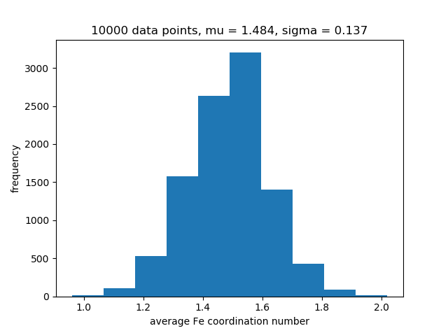
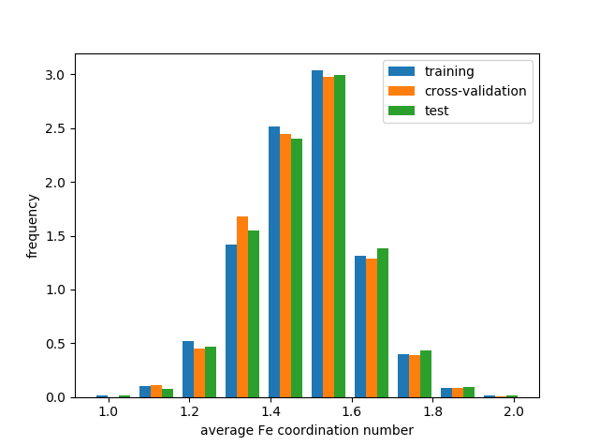
Data Distribution
(normalized)

Slide 14
Tools & Hyperparameters Used
Learning rate: 0.003 found to be best; accuracy similar to 0.001 but with faster convergence
Mini-batch gradient descent
Especially important to use here since we have a large data set (10000), greatly speeds up / improves training
Mini-batch of 16 again found to be effective
Normalization of input data
Batch normalization
Dropout: again found to be ineffective, not used here
Regularization
With no regularization (set factor to 0), the model already didn’t overfit
Training and cross-validation cost functions are basically equal
Possibly because such a large data set was used, so the training data generalized readily
Data augmentation is also known to have a large regularizing effect
As such, no explicit regularization was required
Activation function: set to ReLU
Optimization algorithm: Adam

Slide 15
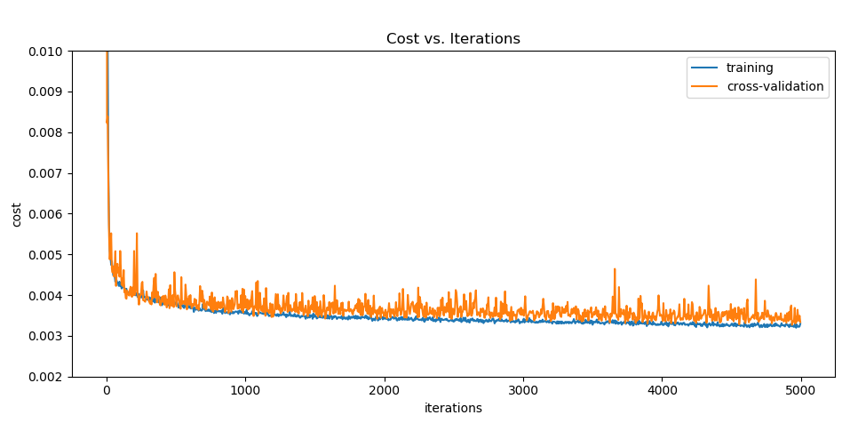
Number of Iterations
Early stopping isn’t as relevant here, because the cross-validation stays relatively constant after a while
As such, we set the network to stop training at 2000 iterations; further training does not seem to lead to significant improvement
Also, both cost curves are roughly equal, so the model has low variance (does not overfit much)

Slide 16
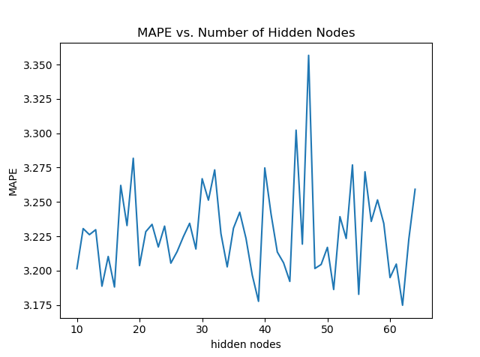
Network Structure vs. Cross-Validation Set Accuracy
Rather than only picking the model with the lowest cross-validation MAPE, it is useful here to test a few of the best models on two test sets
The original test set
A test set consisting of only ‘real averages,’ i.e. those formed by averaging the 49 spectra that belong to a single POSCAR/CONTCAR
Ultimately, this model will be used on data that was not artificially created, so it is important that it works well on the ‘real averages’
Here, most MAPEs are within 0.1% of each other, which is not significant enough to use this as the only metric

Slide 17
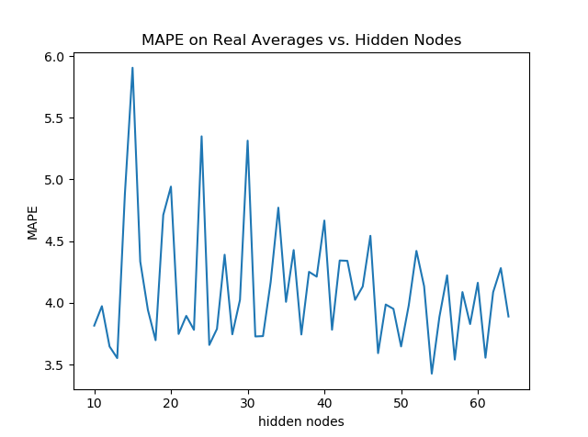
Choosing a Final Network Structure
Original test set confirms that for the most part, all models perform similarly on the augmented data, suggesting we need another metric to choose the best model
When plotting the MAPEs obtained by the models on the new test set, the 53-node model is found to be best
With the knowledge we have, the 53-node model should generalize best to actual, non-augmented data
53-node model performance on earlier train/cross-validation:
Train set: 3.08% MAPE
Cross-validation set: 3.28% MAPE

Slide 18
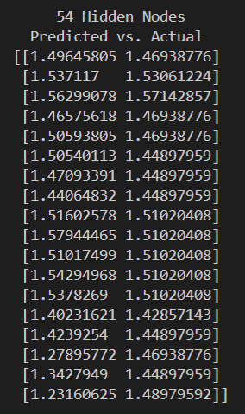
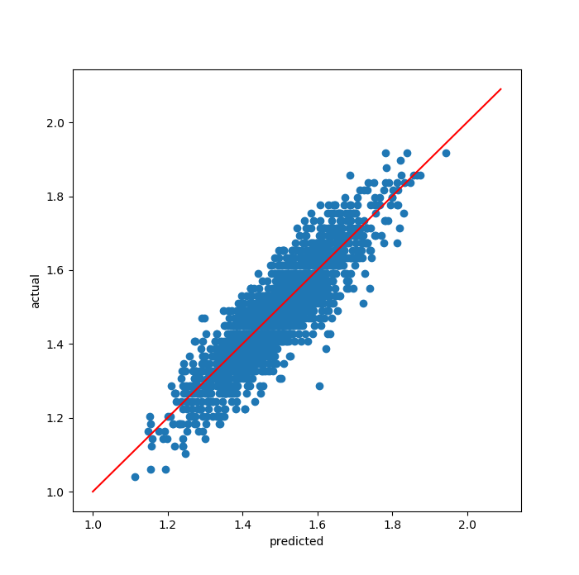
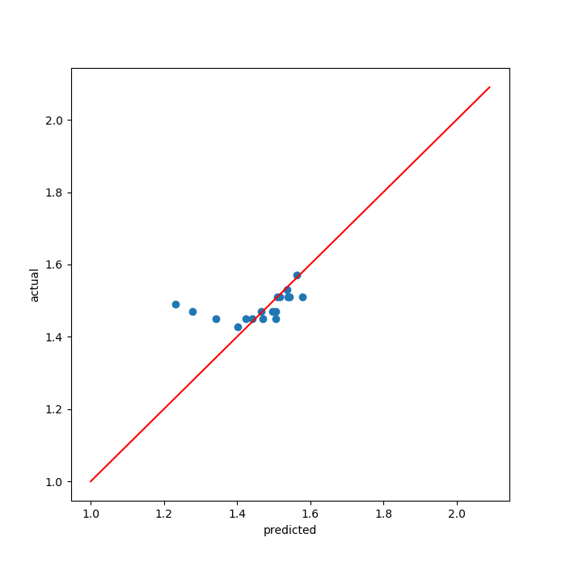
Results
Mean absolute errors and percentage errors
Original test set: 0.049 (1/3 of standard deviation), 3.35%
New test set: 0.051, 3.43%
Note for further investigation: the three predictions where the prediction value is <= 1.4 and under-estimates the actual value (as seen on the graph to the right) are the last 3 rows in the output matrix, which correspond to the last 3 CONTCAR files from the folder 1000K
Removing these 3 values and reevaluating leaves only a 1.60% MAPE
Performance on Original Test Set
Performance on New Test Set

Slide 19
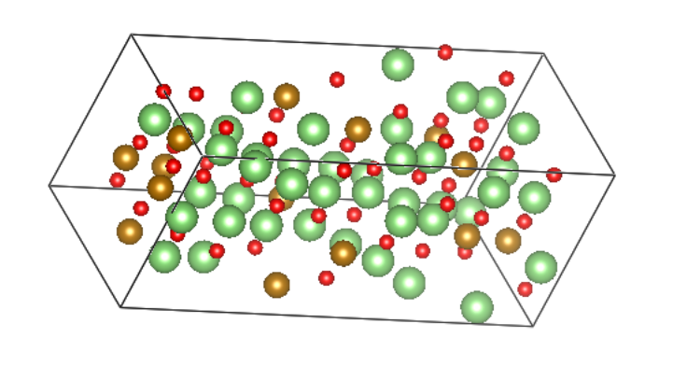
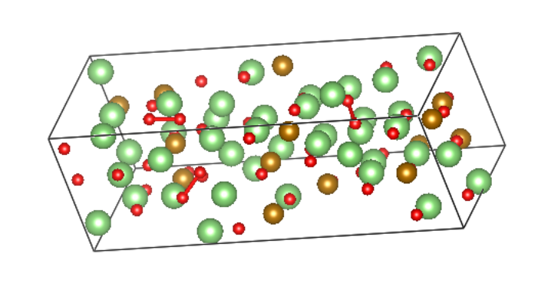
The Difference with the 1000K Values
last 300K structure: no O-O dimers
Most of the other structures were taken at 300K
The last three structures at 1000K were left at the longest time
At such high temperatures, those with remain the longest tend to form the most oxygen-oxygen bonds
This structural difference affects the spectra in such a way that the network will tend to underestimate the structure’s actual average coordination number
Future model considerations: incorporate other features, such as the number of oxygen-oxygen bonds, in order to train the network
last 1000K structure: three O-O dimers

Slide 20
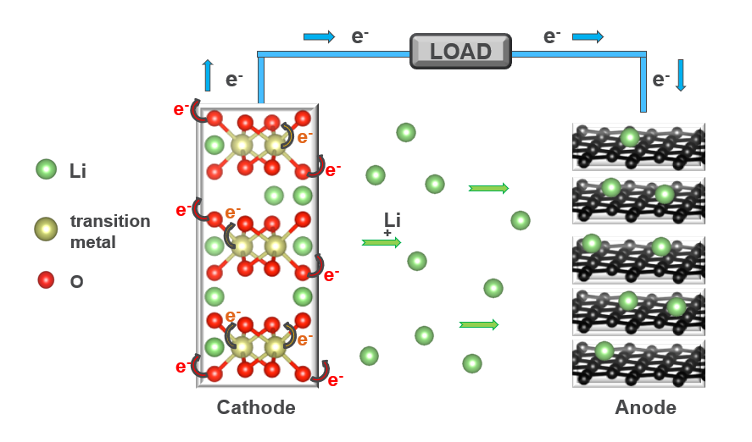
Charge Analysis with Regression
Objective: given a spectrum for a single oxygen atom, predict the charge on that atom
15 Li3FeO3.5 structures used, 49 spectra per POSCAR/CONTCAR file
Did not use 3 of the structures used in the other models; lacked charge data
Neural network: trained for regression, using much of the same framework as for the averaged spectra analysis
Major difference is the task of choosing a new set of optimal hyperparameters, as they vary between applications
(Liang Li)

Slide 21
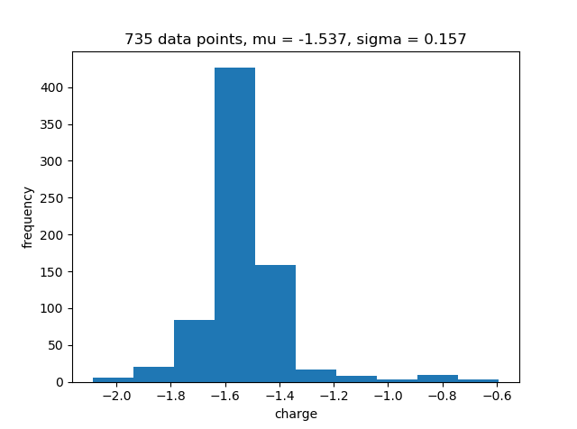
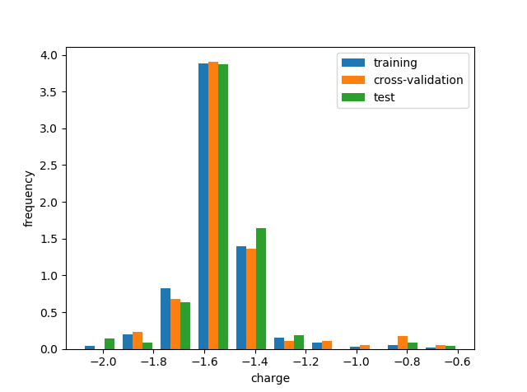
Charge Data Distribution
(normalized)

Slide 22
Tools & Hyperparameters Used
Learning rate: 0.0003
Mini-batch size: 32
Normalization of input data
Batch normalization
Dropout: ineffective, not used
Regularization: set factor to 0.01
Activation function: set to ReLU
Optimization algorithm: Adam

Slide 23
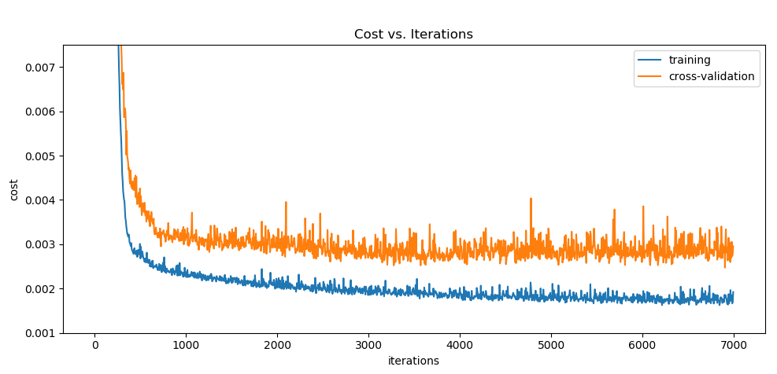
Number of Iterations
Based on this cost graph when training the 40 hidden node model, ~4000 iterations is a good place to stop

Slide 24
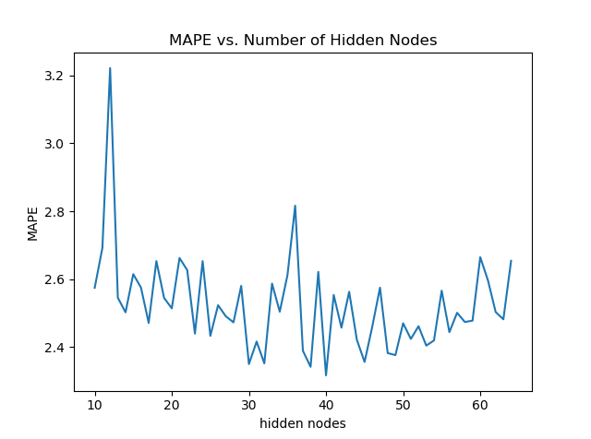
Network Structure vs. Cross-Validation Set Accuracy
Based on the MAPEs of different models on the cross-validation set, we choose the model with 40 hidden nodes as our optimal model

Slide 25
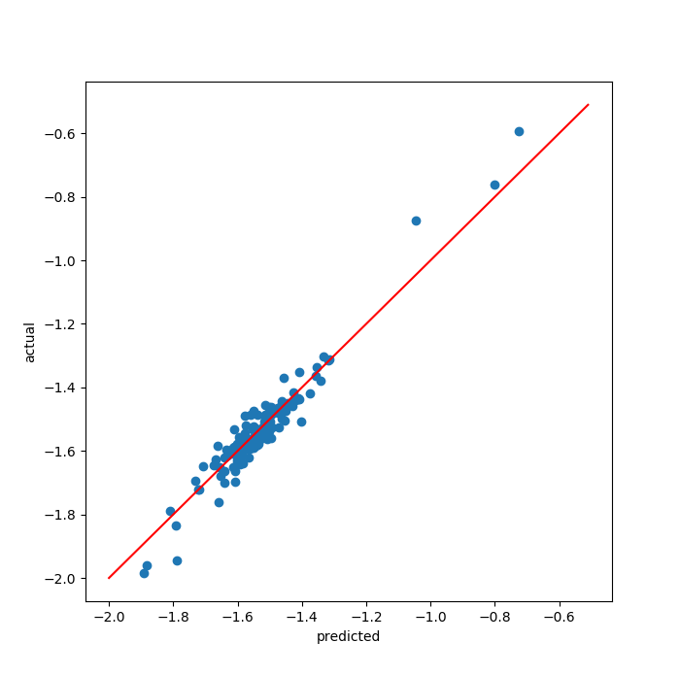
Results
Accuracy of prediction (MAPEs)
Train set: 1.48%
Cross-validation set: 2.31%
Test set: 2.15%
Mean absolute error (MAE) on test set: 0.03
= 1/5 of standard deviation
Performs well on extreme values, but training on more data points for both ends would strengthen the model

Slide 26
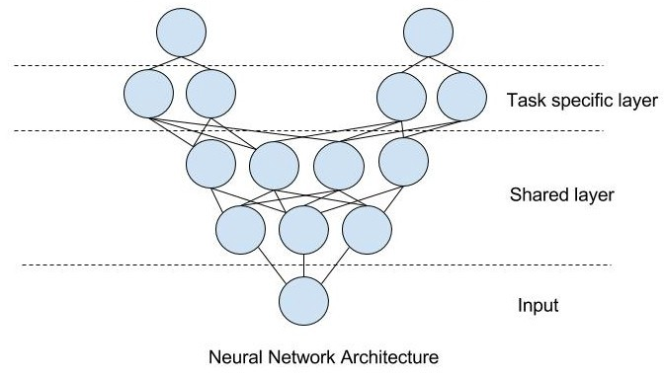
Multi-Task Learning
Objective: combine the coordination number classification task and charge regression task into one model to optimize both simultaneously
Relatively new technique, motivated by how humans think
We process many related tasks simultaneously, as certain information can be used for multiple tasks
By combining multiple tasks, the goal is to achieve better results on all tasks, compared to when trained separately
Structure
Shared layer designed to compute features useful for both tasks
Its outputs are sent to separate, task-specific layers
Measure of accuracy: classification accuracy minus regression MAPE
Fe Coordination Number
Charge
(Kajal Gupta)

Slide 27
Tools & Hyperparameters Used
Network structure: 100 nodes in shared layer, 50 in each task-specific layer
Did not have time to test more structures; better to train a bigger network than a smaller one
Learning rate: 1e-6
3e-6 is too fast, hard to precisely determine when to stop
Mini-batch size: 16
Normalization of input data
Batch normalization
Dropout: ineffective, not used
Regularization factors: different per task
Coordination classification: 0.3
Charge regression: 0.03
Activation function: set to ReLU
Optimization algorithm: Adam
Coordination Beta
 | 0.003 | 0.01 | 0.03 | 0.1 | 0.3 | 1
0.003 | 62.31 | 62.34 | 62.41 | 62.58 | 63.14 | 55.65
0.01 | 62.46 | 62.49 | 62.52 | 62.60 | 63.17 | 55.76
0.03 | 62.44 | 62.46 | 62.50 | 62.65 | 63.17 | 55.83
0.1 | 61.88 | 61.92 | 61.98 | 62.22 | 62.85 | 56.44
0.3 | 60.25 | 60.27 | 60.32 | 60.76 | 61.31 | 54.81
Charge Beta

Slide 28
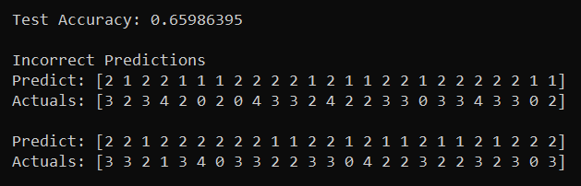
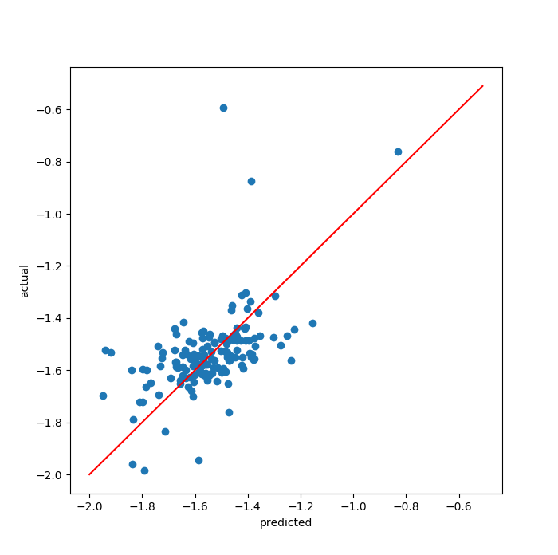
Results
Coordination classification accuracy
Train set: 0.73
Cross-validation set: 0.71
Test set: 0.66
Notes
Predictions seem to heavily lean towards 1 and 2; fails to predict values of 3 or 4, and many values of 0
Prediction power fairly weak; most likely will need more training examples for labels with extreme values
Charge regression MAPE
Train set: 4.93%
Cross-validation set: 8.01%
Test set: 7.47%
Notes
Cross-validation and test set performance fairly similar, so the model does generalize; however, the prediction power is much weaker than the model trained on this task alone
Struggles especially with charges closer to 0; training with more data in this range would be beneficial

Slide 29
Summary and Conclusion
Coordination Number Classification: neural network with two hidden layers
94% accuracy
Close to optimal performance
Average Coordination Regression: neural network with one hidden layer
3.43% mean absolute percentage error
Future consideration: take the number of O-O dimers into account
Charge Regression: neural network with one hidden layer
2.15% mean absolute percentage error
Near optimal; more training examples at both extremes would be beneficial
Multi-Task: Coordination Classification with Charge Regression
Hidden layers: one shared layer, two task-specific layers
Classification: 66% accuracy, regression: 7.47% MAPE
A multi-task approach has potential, but based on the hyperparameters and structures tested, in this case, performance most likely will not surpass the models trained individually
Would be more useful to try if performance had been poor on both when trained individually
Neural networks are versatile, have potential for many other XANES analysis applications

Slide 30
Links
Deep learning introduction: https://www.coursera.org/specializations/deep-learning
Dropout: http://jmlr.org/papers/volume15/srivastava14a.old/srivastava14a.pdf
Batch normalization: https://arxiv.org/pdf/1502.03167.pdf
Adam optimizer: https://arxiv.org/pdf/1412.6980.pdf
Multi-task learning: https://arxiv.org/pdf/1706.05098.pdf
X-ray absorption spectroscopy: http://xafs.org/Tutorials?action=AttachFile&do=get&target=Newville_xas_fundamentals.pdf
Supervised ML determination of metallic nanoparticles: https://pubs.acs.org/doi/abs/10.1021/acs.jpclett.7b02364
Deep networks for predicting crystal stability: https://www.nature.com/articles/s41467-018-06322-x.pdf
NN approach to characterize structural transformations in XAFS: https://journals.aps.org/prl/pdf/10.1103/PhysRevLett.120.225502

